Slide 1
Introduction to Distributed Systems
Lecturer: Ngo Huy Bien
Software Engineering Department
Faculty of Information Technology
VNUHCM - University of Science
Ho Chi Minh City, Vietnam
nhbien@fit.hcmus.edu.vn

Slide 2

Objectives
To communicate in distributed systems field.

Slide 3

Contents
Distributed Systems.
Performance & Scalability.
Fault Tolerance.
Consistency.
System Models.
Communication.
Ordering.

Slide 4

References

Slide 5
What is a Distributed System?
multiple computers (computers, phones, cars, robots) communicating via a network
trying to achieve some task together
No shared operating system.
No shared memory.
No shared clock.
“a system in which the failure of a computer you didn't even know existed can render your own computer unusable.”
— Leslie Lamport

Slide 6
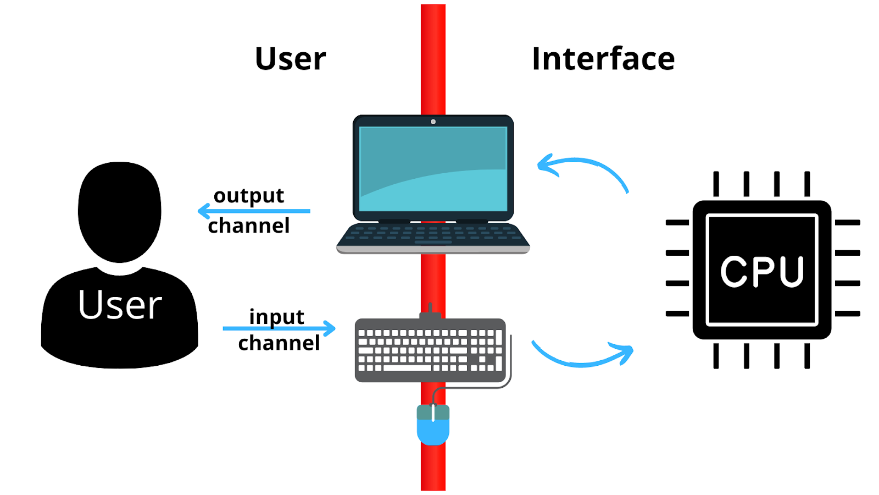
Distributed System Characteristics
Collection of independent computers that appears as a single system to the user(s).
Independent = autonomous, self-contained.
Single system = user not aware of distribution (network and location transparency).

Slide 7
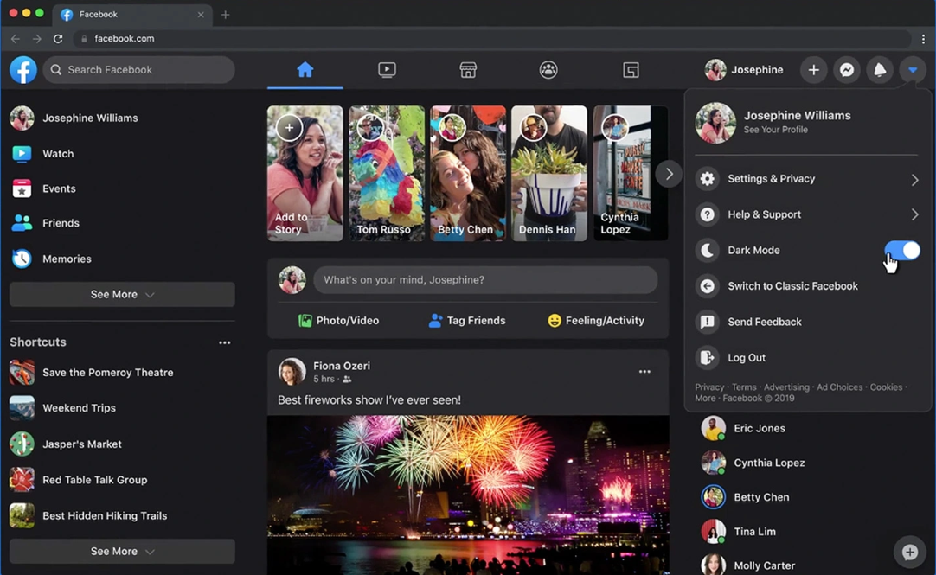
Example Distributed Systems
Facebook.
Google Search.
YouTube.
Gmail.
Netflix.
Amazon.
Office 365.
Any big web sites.

Slide 8

Why Distributed Systems?
To increase compute and storage.
To tolerate faults via replication.
To place computing physically close to external entities.
To achieve security via isolation.

Slide 9
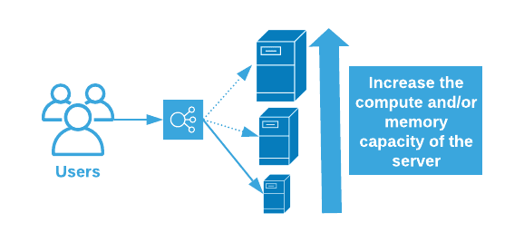
How to Increase Compute and Storage
Ideas: Scalability, load balancing, data sharding.
Scalability goal: scalable throughput.
N x Servers will lead to N x Total throughput via parallel CPU, disk, net.
So handling more load only requires buying more computers.
Rather than re-design by expensive programmers.
Effective when you can divide work without much interaction.

Slide 10
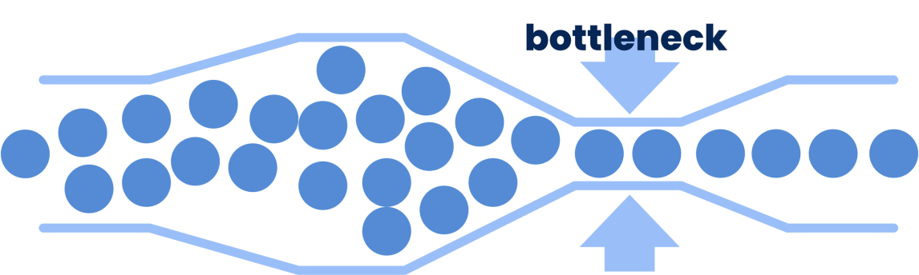
Why Achieving Scalability is Hard
Scaling gets harder as N grows:
Load imbalance, stragglers, slowest-of-N latency.
Non-parallelizable code: initialization, interaction.
Bottlenecks from shared resources, e.g. network.
Some performance problems aren't easily solved by scaling
e.g. quick response time for a single user request.
e.g. all users want to update the same data.
often requires better design rather than just more computers.

Slide 11


Slide 12

Fault Tolerance
Failure: System as a whole isn't working.
Fault: Some part of the system isn't working.
Fault tolerance: System as a whole continues working, despite faults (some maximum number of faults assumed).
In a network with thousands of servers, failures are inevitable.
We'd like to hide these failures from the application.
We often want:
Availability: app can make progress despite failures.
Recoverability: app will come back to life when failures are repaired.

Slide 13
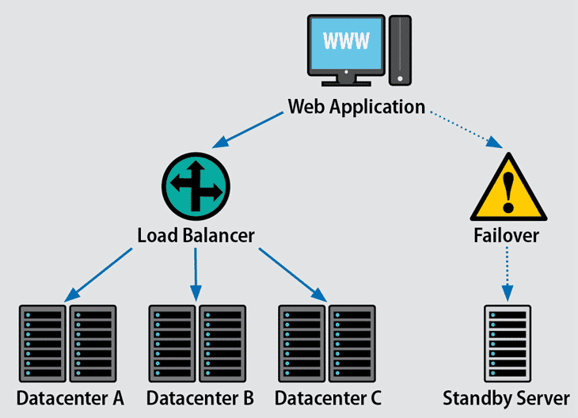
How to Achieve Fault Tolerance
Idea: Replicated servers.
If one server crashes, can proceed using the other(s).
However, replication introduces consistency challenges.

Slide 14

Read-Your-Write Consistency
Read-your-write consistency: Process A after it has updated a data item always accesses the updated value and never will see an older value.
General-purpose infrastructure needs well-defined behavior.
E.g. "Get(k) yields the value from the most recent Put(k,v)."

Slide 15
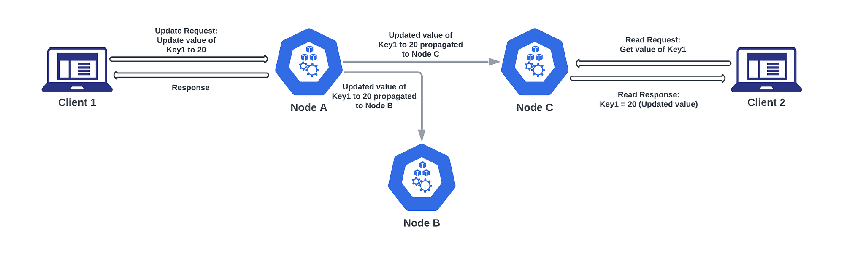
Strong Consistency
Strong consistency: all nodes in the system see the same data at the same time, regardless of which node they are accessing.
Crucial for businesses relying on data correctness.
Strong consistency and performance are enemies.
Strong consistency requires communication.
Performs repair before returning results.

Slide 16
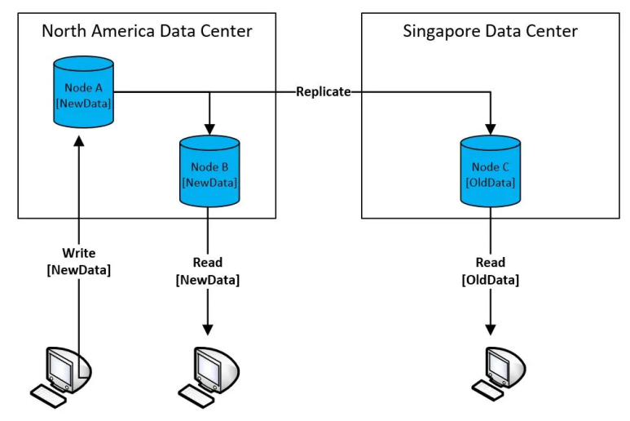
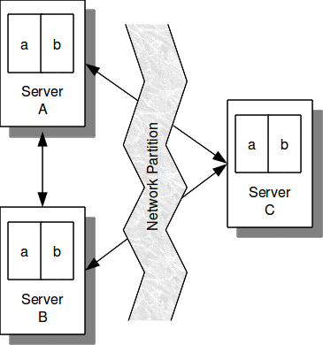
Why Strong Consistency is Hard
"Replica" servers are hard to keep identical.
Clients may crash midway through multi-step update.
Servers may crash, e.g. after executing but before replying.
Network partition may make live servers look dead; risk of "split brain".

Slide 17
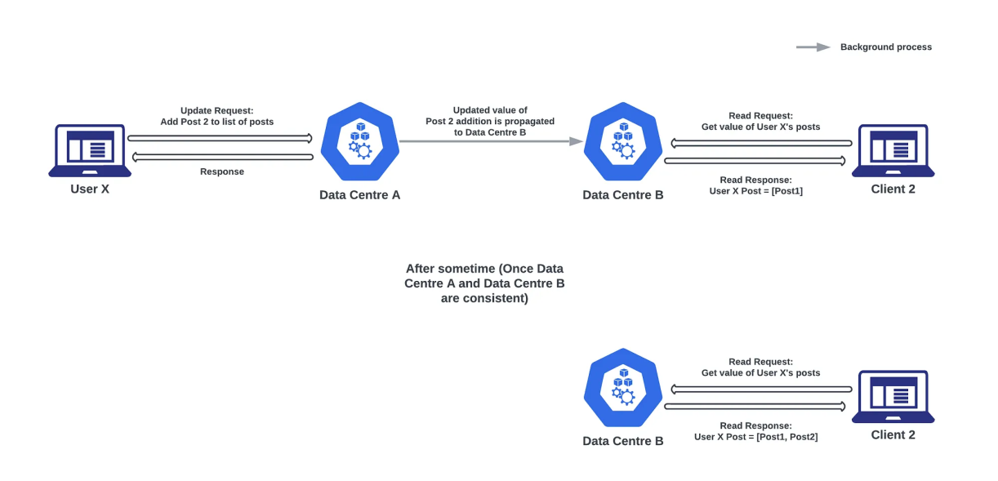
Weak Consistency
Over time, the system converges towards consistency, but during the transient period, users accessing different data centers may observe different versions of the data.
Many designs provide only weak consistency, to gain speed.
e.g. Get() does NOT yield the latest Put()!
Performs repair after returning results.
Painful for application programmers but may be a good trade-off.

Slide 19
Network Behavior
Assume bidirectional point-to-point communication between two nodes, with one of:
Reliable (perfect) links:
A message is received if and only if it is sent.
Messages may be reordered.
Fair-loss links:
Messages may be lost, duplicated, or reordered.
If you keep retrying, a message eventually gets through.
Network partition: Some links dropping or delaying all messages for period of time.
Arbitrary links (active adversary):
A malicious adversary may interfere with messages (eavesdrop, modify, drop, spoof, replay).
Retry and
De-duplication
TLS

Slide 20
Node Behavior
Each node executes a specified algorithm, assuming one of the following:
Crash-stop (Fail-stop):
A node is faulty if it crashes (at any moment).
After crashing, it stops executing forever.
Crash-recovery (Fail-recovery):
A node may crash at any moment, losing its in-memory state. It may resume executing sometime later.
Byzantine (Fail-arbitrary):
A node is faulty if it deviates from the algorithm.
Faulty nodes may do anything, including crashing or malicious behavior.
A node that is not faulty is called “correct”.

Slide 21
Timing
Assume one of the following for timing (synchrony) of network and nodes:
Synchronous:
Message latency no greater than a known upper bound.
Nodes execute algorithm at a known speed.
Asynchronous:
Messages can be delayed arbitrarily.
Nodes can pause execution arbitrarily.
No timing guarantees at all.
Partially synchronous:
The system is asynchronous for some finite (but unknown) periods of time, synchronous otherwise.

Slide 22
System Models
For each of the three parts, pick one:
Network
Reliable, fair-loss, or arbitrary
Nodes:
Crash-stop, crash-recovery, or Byzantine
Timing:
Synchronous, partially synchronous, or asynchronous
This is the basis for any distributed algorithm.
If your assumptions are wrong, all bets are off!

Slide 24
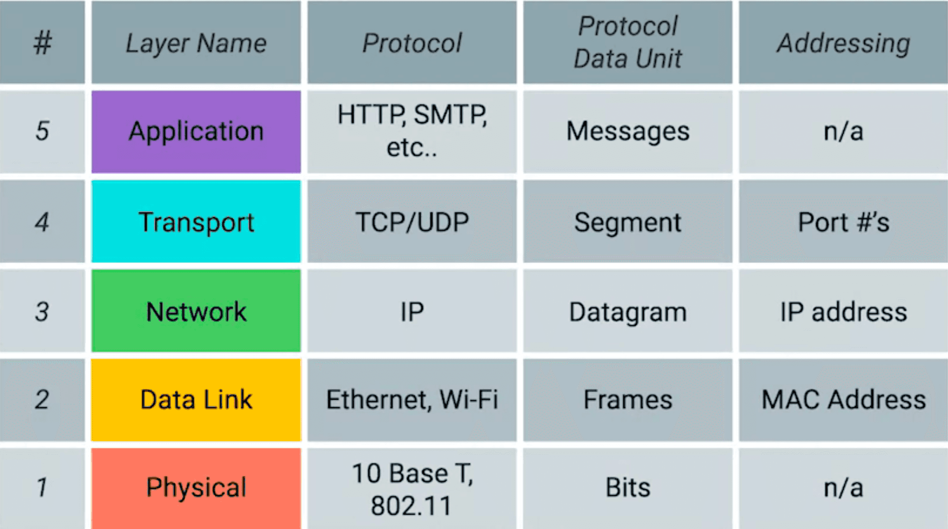
The TCP/IP Five-Layer Network Model

Slide 25
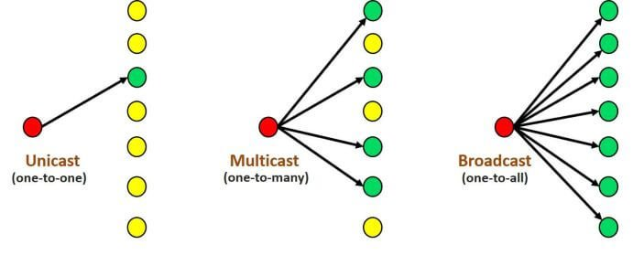
Communication
Reliable Unicast, Multicast, Broadcast.
Unreliable Unicast, Multicast, Broadcast.
Our focus is on inter-node communication at the application layer, rather than at the Ethernet (MAC), network (IP), or transport (port) layers.

Slide 27
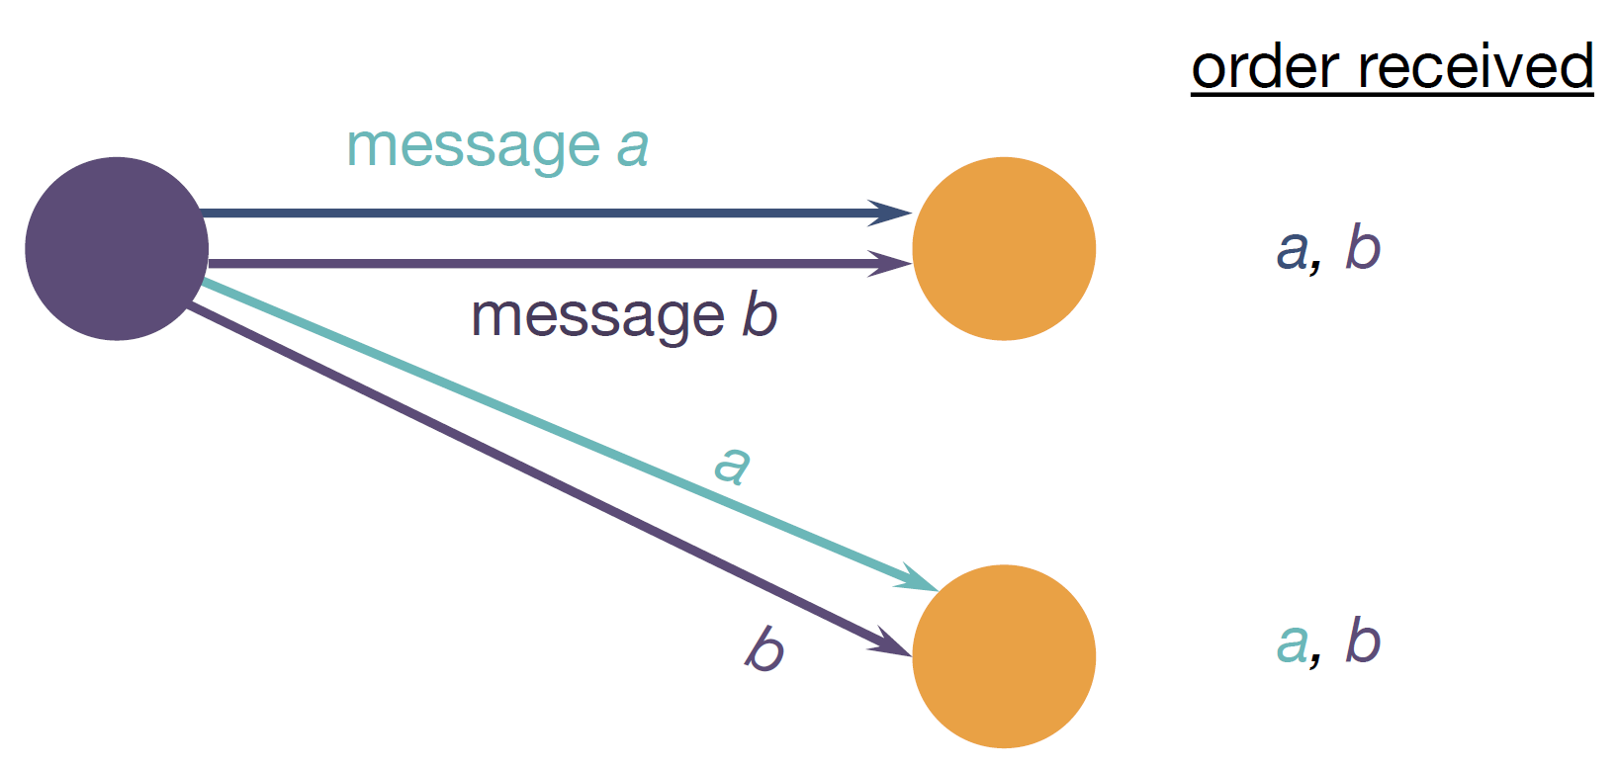
Consistent (Good) Ordering
Single sender multicasting a stream of messages.

Slide 28
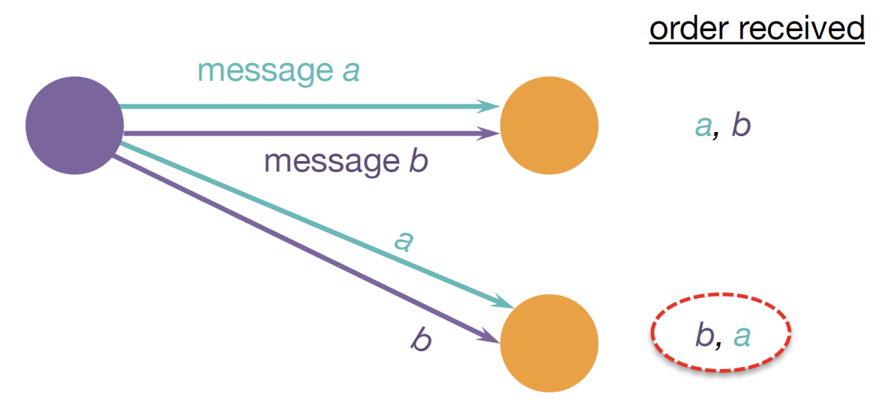
Inconsistent (Bad) Ordering
Single sender multicasting a stream of messages.

Slide 29
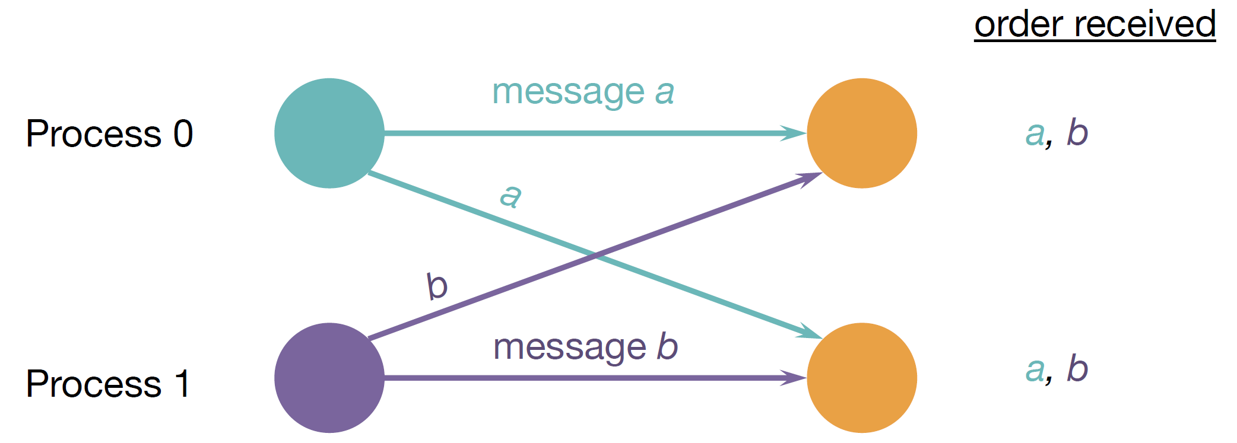
Consistent (Good) Ordering
Multiple senders multicasting a stream of messages.

Slide 30
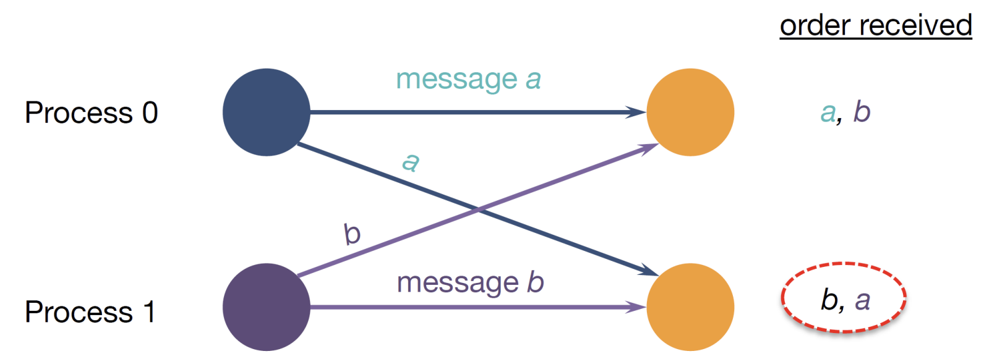
Inconsistent (Bad) Ordering
Multiple senders multicasting a stream of messages.

Slide 32

Why NOT Make a System Distributed?
Many concurrent parts, complex interactions.
Must cope with partial failure.
Communication may fail (and we might not even know it has failed).
Processes may crash (and we might not know).
All of this may happen non-deterministically.
Tricky to realize performance potential (100 computers =? 100 x speed).

Slide 34
More on Distributed System Characteristics (I)
Location transparency means that a user or program can access a resource without needing to know where that resource is physically located in the system. The location of the resource is hidden (abstracted) behind a logical identifier or name.
Mobility transparency (sometimes called migration transparency) means that resources (like processes or data) and clients can move from one physical location in the system to another without affecting how users or programs interact with them. In other words, movement within the distributed environment is invisible to applications and users.

Slide 35
More on Distributed System Characteristics (II)
Access transparency in distributed systems refers to the property that users and applications can access resources (like files, services, or devices) in a uniform way without needing to know anything about how those resources are physically implemented or where they are located.
Replication transparency means the system hides the fact that multiple copies (replicas) of a resource exist from users and applications. From the outside, it appears as if there were only one logical copy, even though internally the system may maintain several replicas to improve performance, reliability, availability, or fault tolerance.

Slide 36
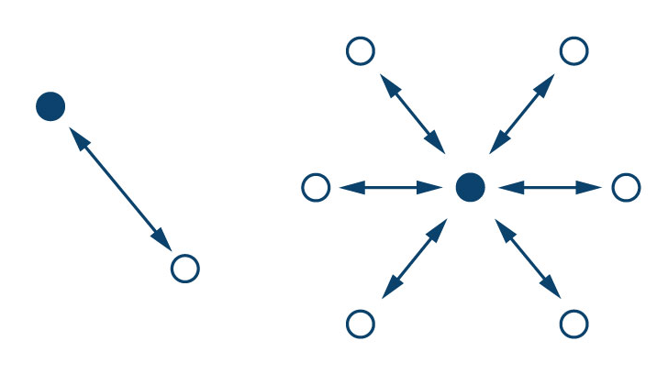
More on Communication
Message passing is a communication paradigm where processes interact exclusively by explicitly sending and receiving messages over a network rather than by sharing memory.
Handshaking: One-time message exchange to establish a connection and verify readiness.
Heartbeat: A node periodically sends heartbeat messages to indicate it is alive.
Polling: A central node periodically asks others if they are alive.

Slide 37

Thank You & See You Again

